Slide 1
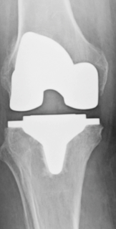
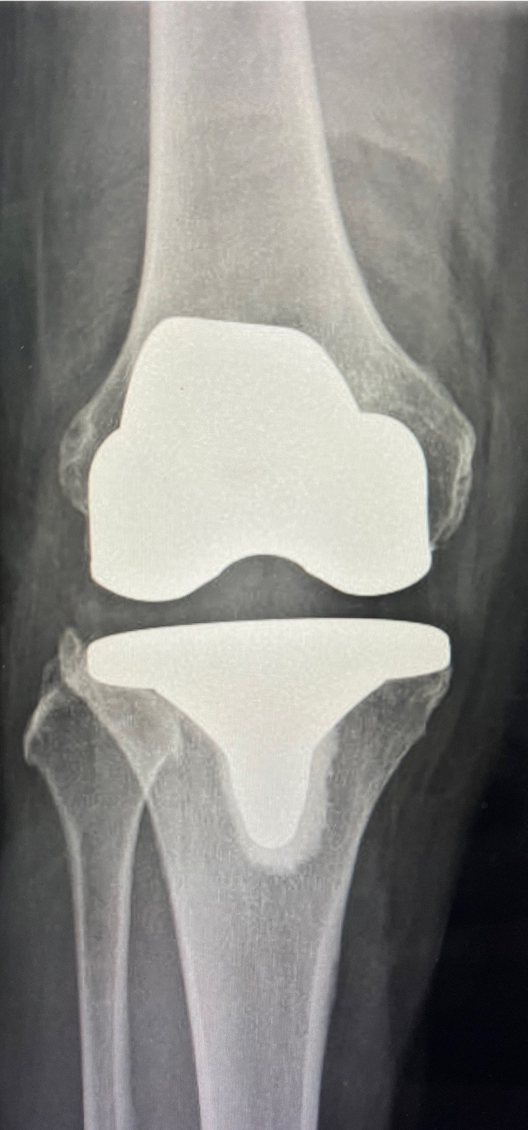
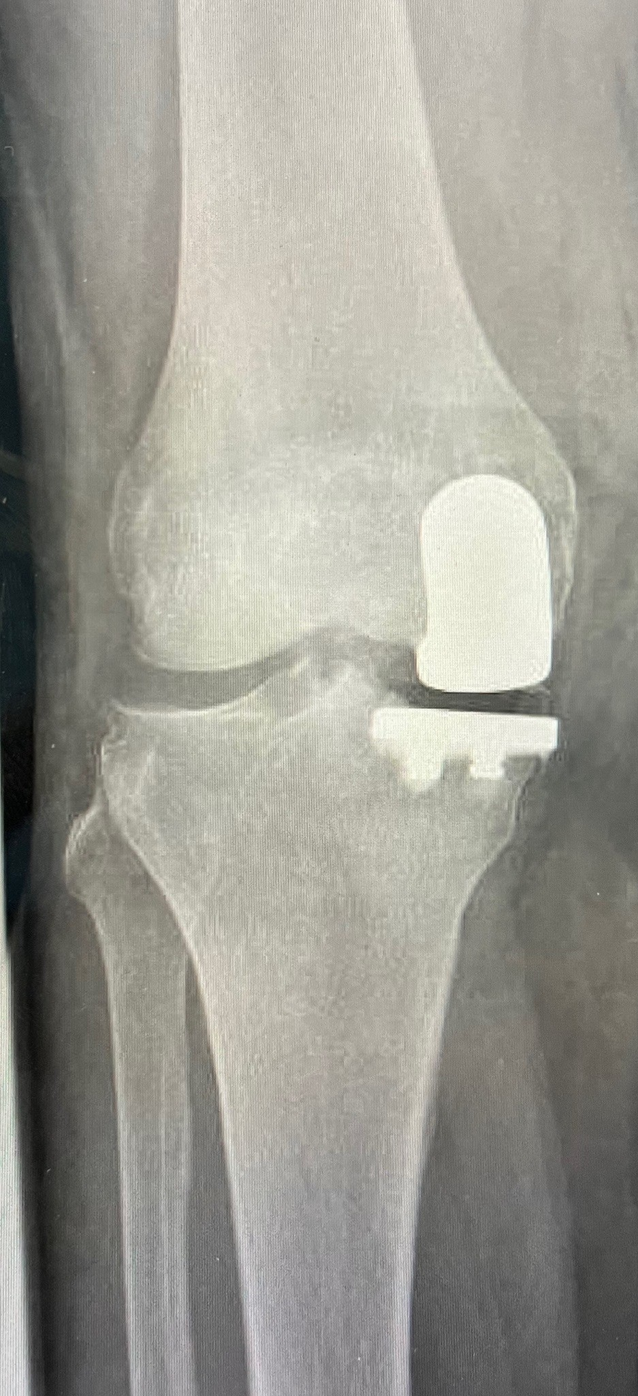
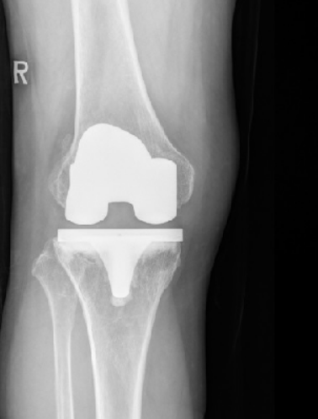
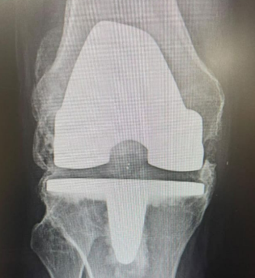
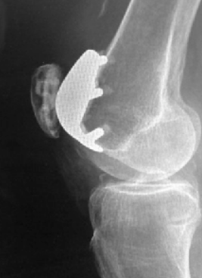
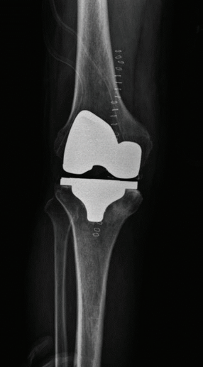
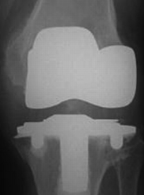
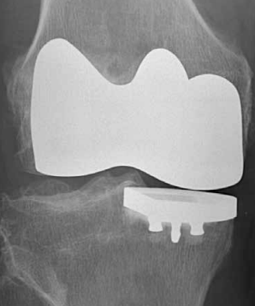
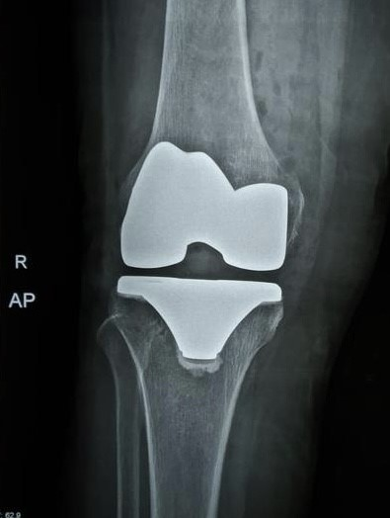
Knee Implants
Depuy Attune
Depuy LCS
Depuy PFC CR Mobile bearing
Depuy sigma partial knee
Exatech Optetrak
Howmedica Avon
Howmedica Duraccon
Howmedica Kinemax
iduo
Implantcast PS fixed bearing

Slide 2
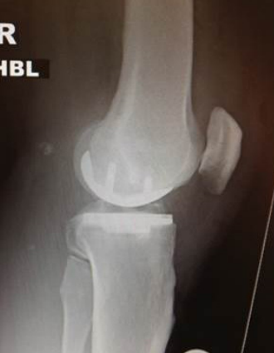
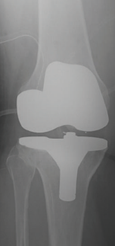
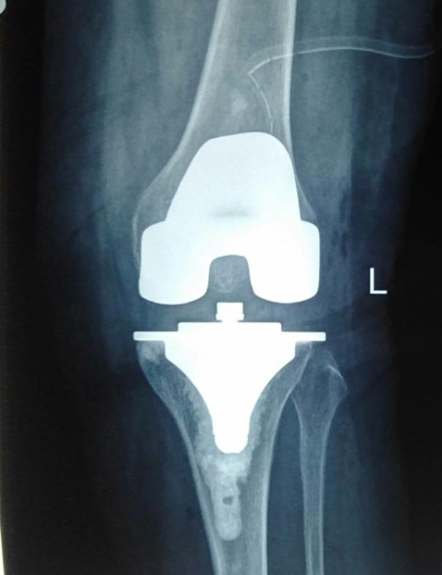
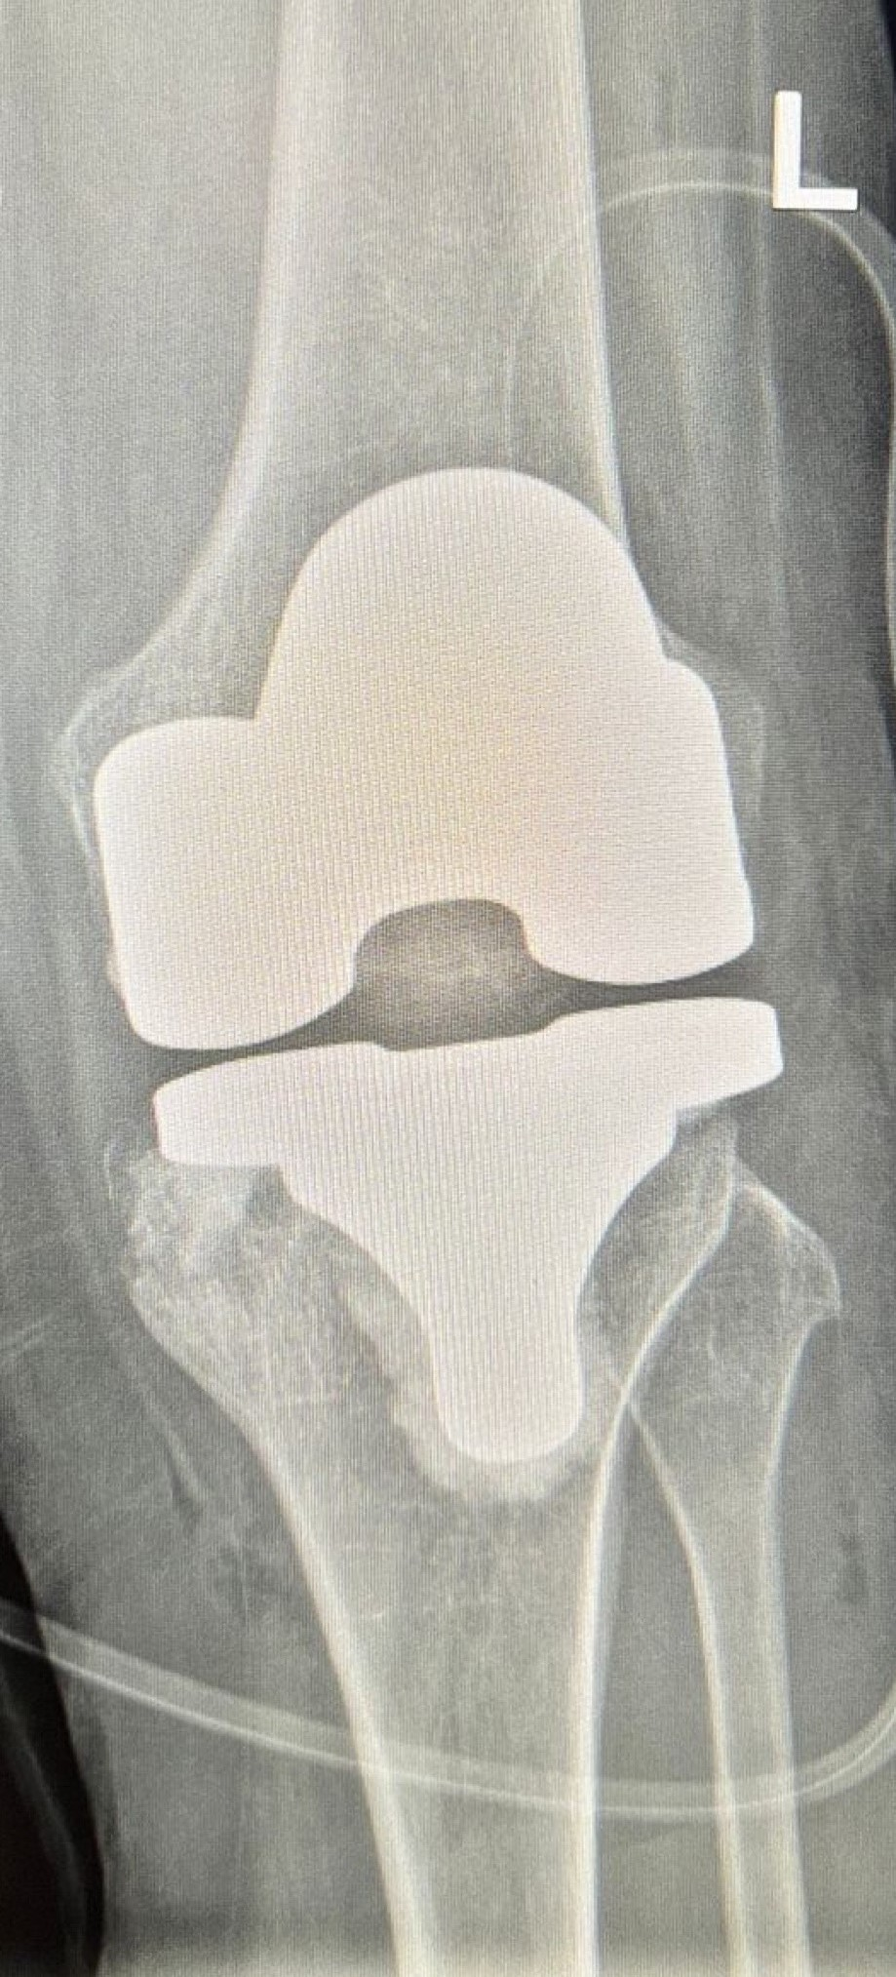
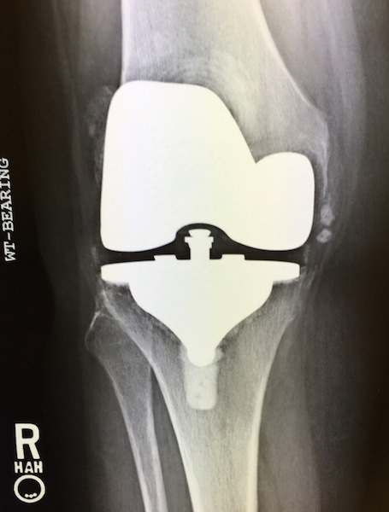
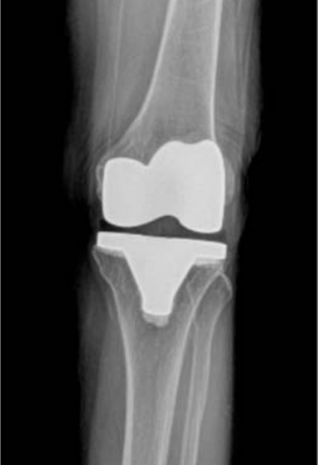
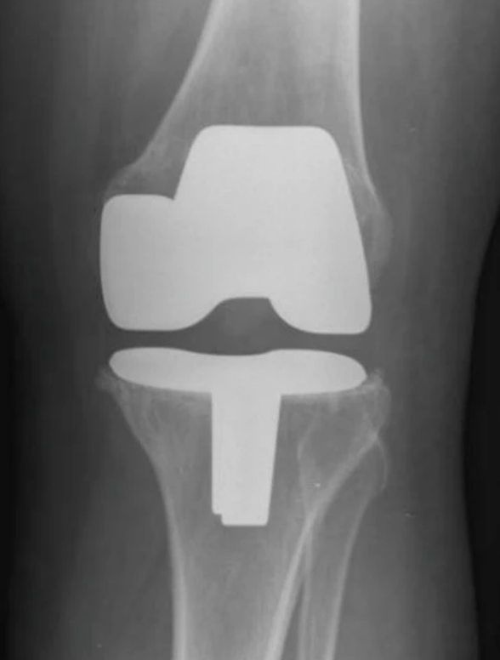
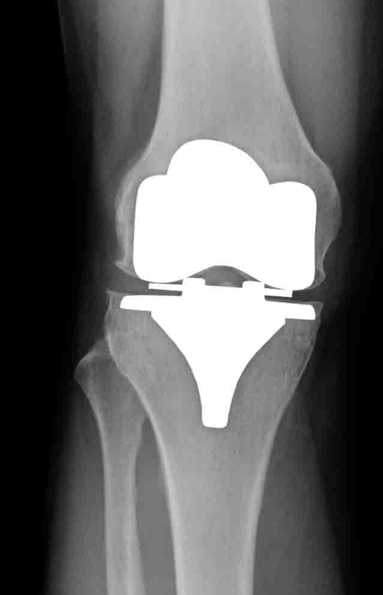
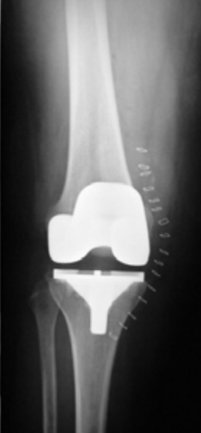
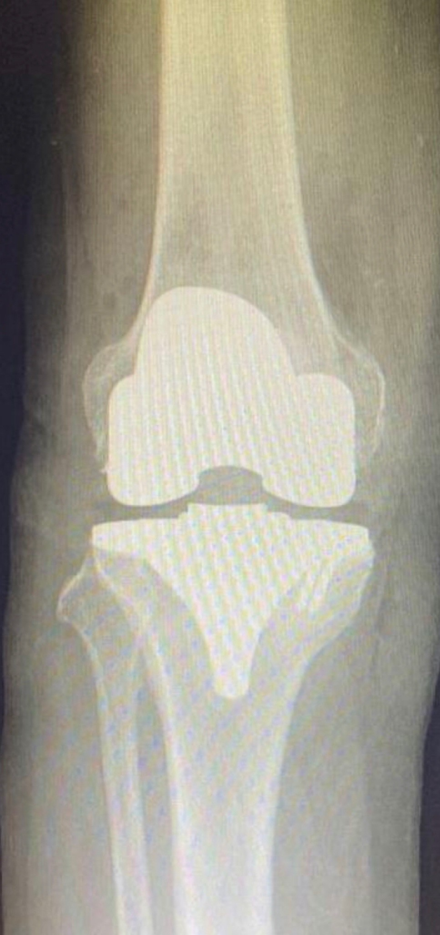
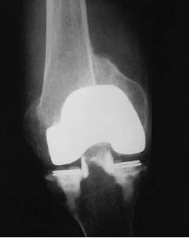
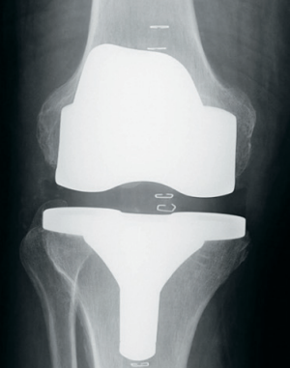
Knee Implants
Adler Ortho Genus
Bbarun Emotion
Bioimpianti Kmod
Corentec Lospo
Depuy AMK
Maxx freedom
Aesculap Columbus
Biomet AGC
Biomet Maxim
Biolox Delta
Biomet Vanguard
Biopro Townley

Slide 3
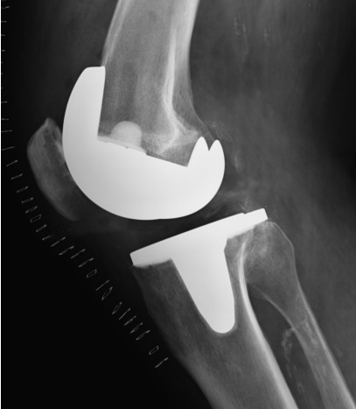
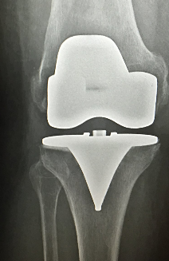
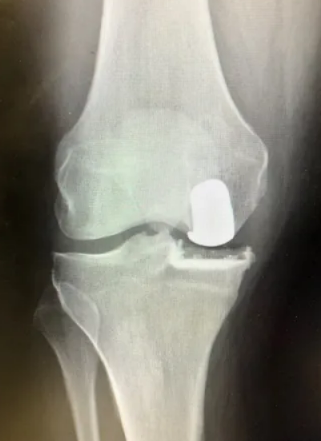
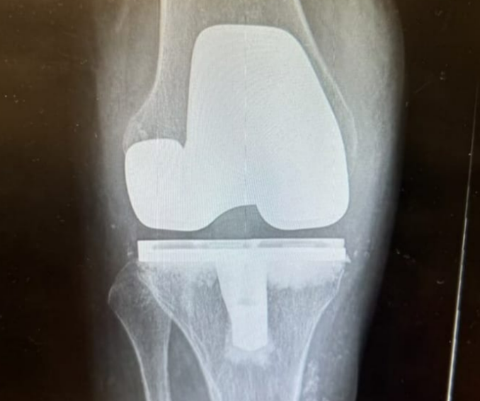
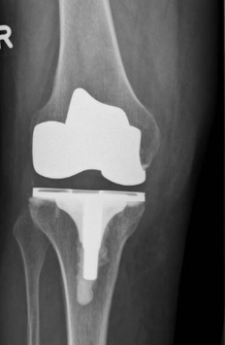
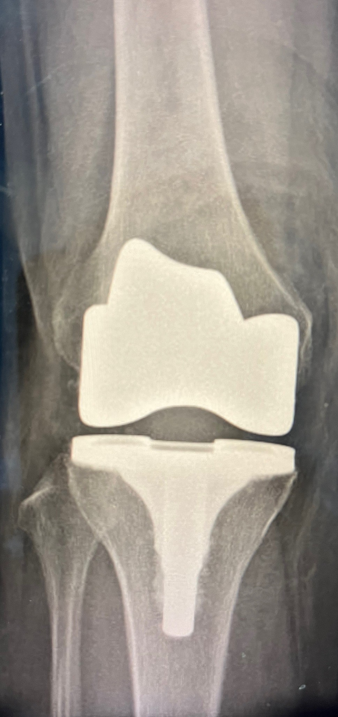
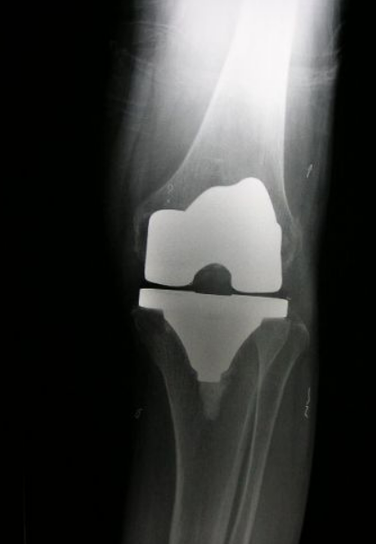
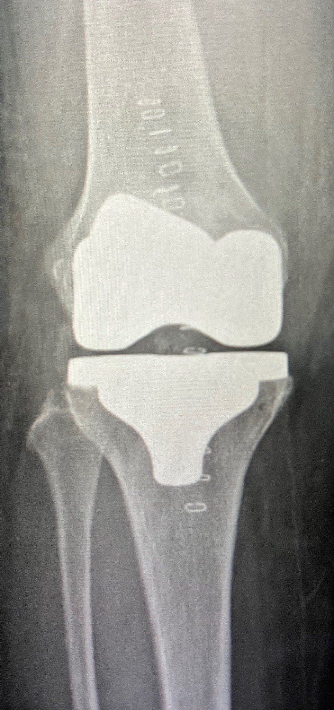
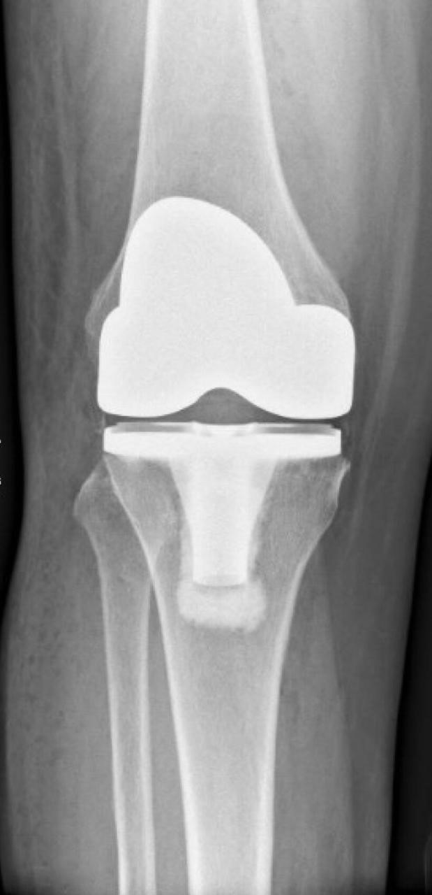
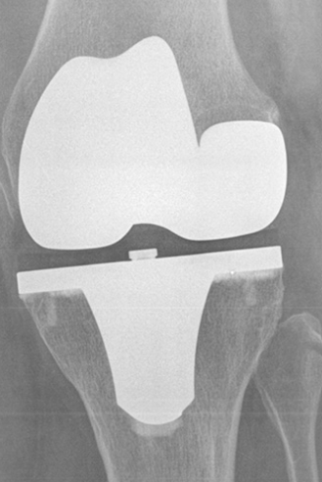
Knee Implants
Microport Evolution
Omni Apex
Repcci
Smith and Nephew Genesis II
Smith and Nephew Journey II
Smith and Nephew Legion
Smith and Nephew TC plus
Strykler Scorpio
Strykler Trihaton
Zimmer Nexgen

Slide 4
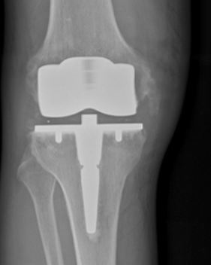
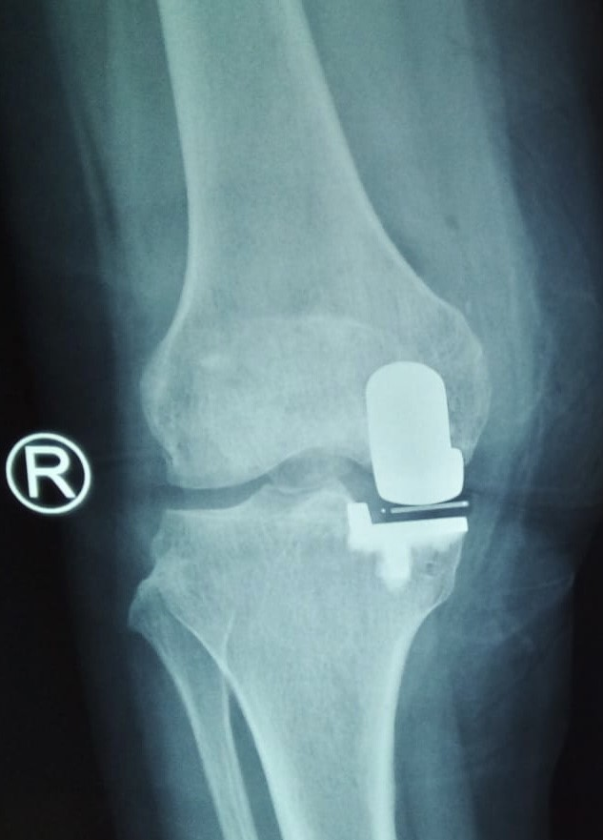
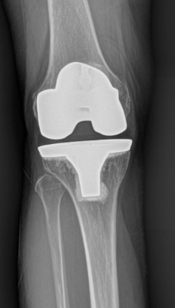
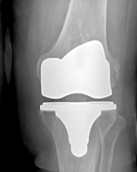
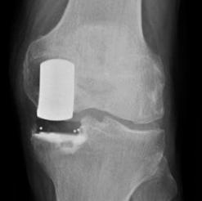
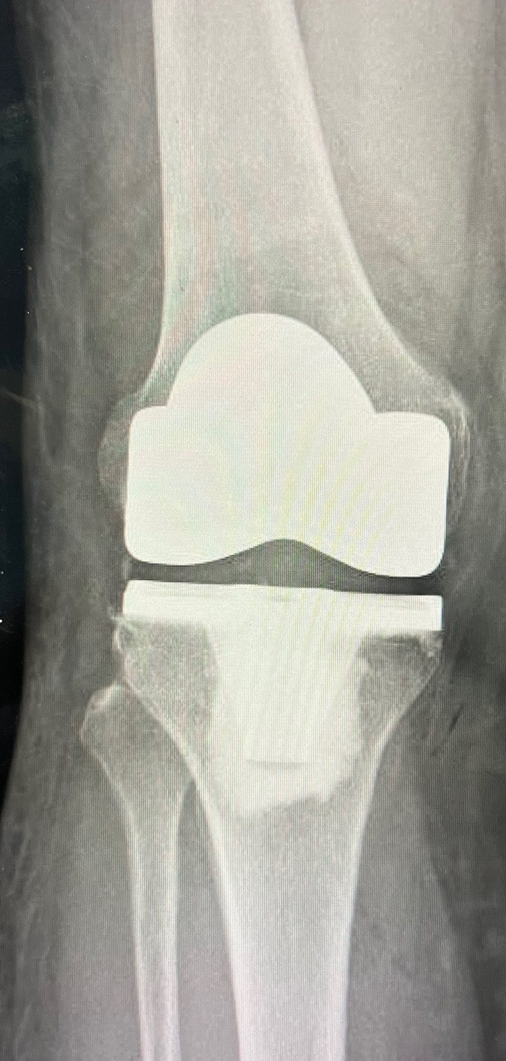
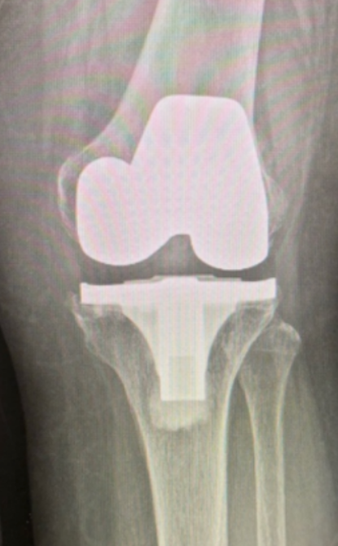
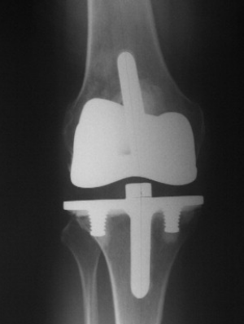
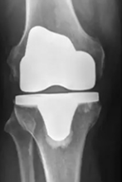
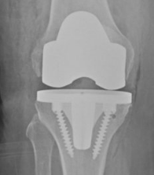
Knee Implants
Zimmer Innex
Zimmer Oxford
Corin uniglide
Exatech Optetrak
Microport Medical Pivot Advance
Zimmer Persona
Wright Medical Advance
DJO Empowr 3D
Exatech Truilent
Corin rotaglide

Slide 5
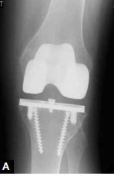
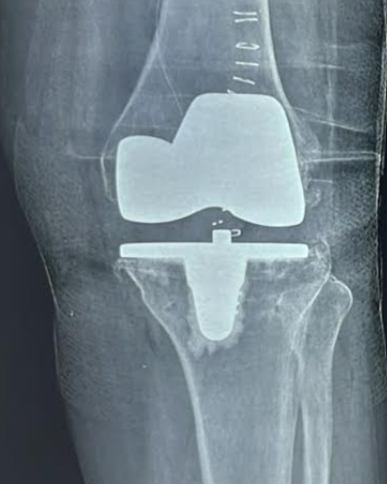
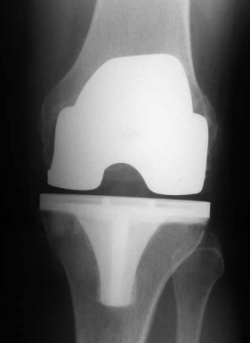
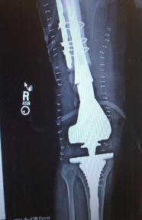
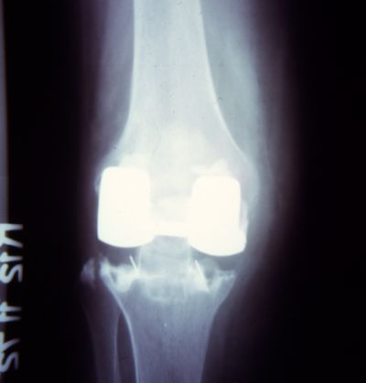
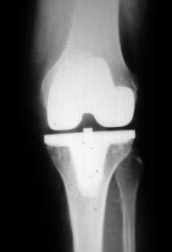
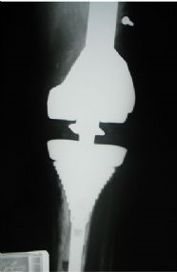
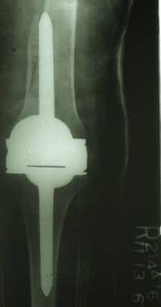


Intermedics Natural Knee
Buchel pappas
Depuy PFC Sigma
Depuy LPS
Howmedica Geometric
DJO Encore Foundation
Depuy Orthogenesis
Howmedica Waldius
 | Link GEMINI SL
Howmedica Eius

Slide 6










MAT ORTHO MRK
wright axiom
STRYKER NRG
Zimmer LPS
Zimmer Biomet LCCK
Smith & Nephew Profix
SMITH & NEPHEW TC PLUS SOLUTION
ZIMMER BIOMET OSS
SMITH & NEPHEW ANTHEM
Stryker Mako

Slide 7


ZIMMER Insall Bursteni
Kyocera Inita CR

Slide 8












Shoulder Implants
Accumed Polarus
Biomet Bio Angular
Biomet Comprehensive
Depuy Delta
Depuy global cap
Arthex Inverse
Arthex Universe
Biboquet
Biomet Verso Reverse
Copeland
Altivate Reverse

Slide 9










Exatech Equinox
Biomet Sidus
Smith and Nephew Promos
Tornier Simpliciti
Lima Corporate SMR
Exatech Interspace
Mathys Affins Short
Smith and Nephew Neer
Stryker O leary
Exatech Equinox

Slide 10










FX Easy Tech
FX Easy Tech Reverse
Zimmer Anatomical
Zimmer Cofield
Smith and Nephew Titan
Tornier Aquelis
Catalyst Ortho
FH Ortho Arrow
Zimmer Bigalini
Zimmer Fenlin

